Slide 1
Azure on all!!
Abdul Rasheed Feroz Khan
Microsoft MVP - Azure

Slide 2
Agenda
Walkthrough Azure
Capacity planning on Azure
Azure DevTest Labs
Lift and Shift on Azure
Azure Site Recovery
Customer Stories on Azure

Slide 3
Azure global infrastructure
50 Azure regions
Available in 140 countries
Up to 1.6 Pbps of bandwidth in a region
Scale globally
Reach more locations, faster, with the performance and reliability of a vast global infrastructure.
Safeguard data
Rely on industry-leading data security in the region and across our network.
Promote sustainability
Help build a clean-energy future and accelerate progress toward your sustainability goals.
Notes:
Azure Functions is actually built on top of the WebJobs SDK

Slide 4
Azure Datacenter
Opened first datacenter in 1989
Investment of more than $15 billion on infrastructure
Geo-replication over 500 miles apart
24x7 monitoring by US screened persons

Slide 5
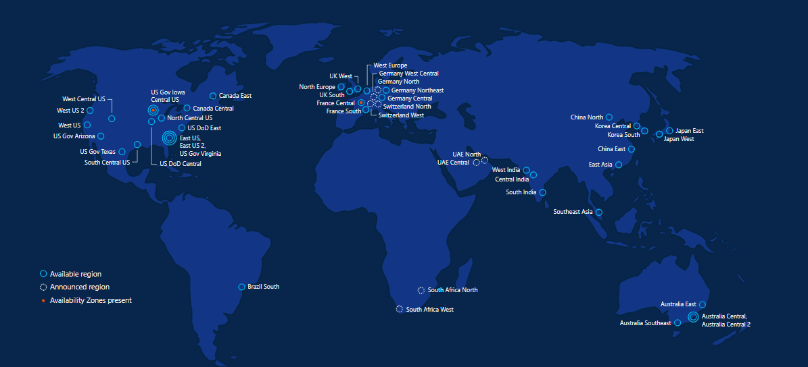
Azure regions – 50 Regions 140 Countries

Slide 6
Azure keep your data secure
Azure safeguards data in facilities that are protected by industry-leading physical security systems and are compliant with a comprehensive portfolio of standards and regulations.

Slide 7
Azure Developer Tools
Build apps that span IaaS and PaaS
Speed development of enterprise, web, mobile and IoT apps
Access the cloud directly from Visual Studio and other standalone and command-line tools
Build cloud apps for Java, Node, Python, Ruby, PHP, or .NET
Run Azure commands from your command-line interface
Diagnose live apps with world-class debuggers, profilers, diagnostic tools and explorers

Slide 8
Azure Developer Tools
Visual Studio Tools for Azure
Azure SDK
Command Line tools
Azure PowerShell
Azure Command-Line Interface (Azure CLI)
PowerShell Tools for Visual Studio 2015
Storage Explorer
Visual Studio Code
Docker Tools
Azure Service Fabric Tools

Slide 9
Capacity Planning & Pricing Strategy

Slide 10
Azure pricing
No upfront cost
Pay only for what you use
Free cost management

Slide 11
How to save
Reserved VM Instances
Save up to 72 percent over pay-as-you-go pricing with an upfront one- or three-year commitment. Exchange or cancel at anytime
Azure Hybrid Benefit
Use your on-premises Windows Server or SQL Server licenses with Software Assurance to save big when migrating a few workloads or entire data centers to the cloud
Dev/Test pricing
Get discounted rates on Azure for your ongoing development and testing, including no Microsoft software charges on Azure Virtual Machines and special dev/test pricing on other services.

Slide 12
Demo Azure Pricing Calculator

Slide 13
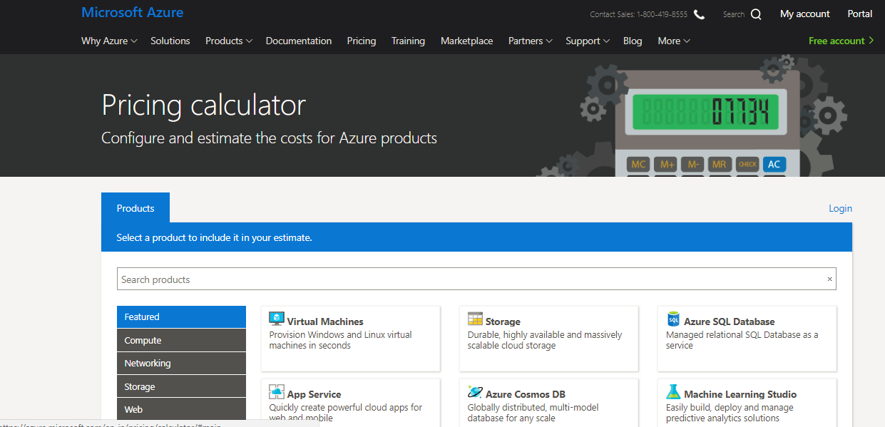
Demo

Slide 14
Azure DevTest Labs

Slide 15
Fast, easy and lean dev-test environments
Fast, easy and lean dev-test environments
Quickly provision development and test environments
Minimise waste with quotas and policies
Set automated shutdowns to minimise costs
Build Windows and Linux environments

Slide 16
Why you should use
Self-service cost control
Provide self-service cloud environments without the worry. Lab policies and thresholds help to effortlessly minimise costs.
Quick custom templates
Set up your virtual machine with your dev tools and your latest build in a few clicks and share reusable templates across your team.
Works with your CI/CD tools
Create environments directly from your continuous integration (CI) tools using our plug-ins, REST API or Visual Studio Team Services extension.

Slide 17
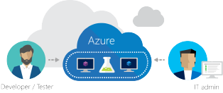
Simplify cost management
Set lab policies to automatically shut down and start up virtual machines.
Set caps on your lab, such as the number of virtual machines per user and per lab.
Use the lab cost trend to estimate your spending and set a threshold.

Slide 18

Quickly set up environments
Use custom images to quickly reproduce your environment.
Install your latest bits and dev tools on your machine through artifacts.
Create formulas to easily modify an environment's configuration at any time.

Slide 19
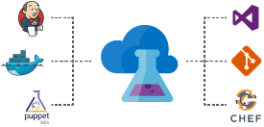
Integrate with your existing toolchain
Use our REST API to provision dev-test environments directly from your continuous integration (CI) tools.
Quickly deploy from your release pipeline using our Team Services tasks extension.
Use our command line tool to automate your virtual machine set up and clean up.

Slide 20

Tailor to your scenario
Centrally manage development environments across your team or organisation.
Conduct compatibility and automated testing with reusable environment templates.
Provide virtual machines for hackathons that automatically expire after the event.
Use the service for different scenarios to suit your needs.

Slide 21

Customers
"It used to take us six months to a year to develop a new offering for a customer, but now that we do this work in Azure DevTest Labs, we can respond in a few weeks."
Gordon McKenna, Chief Technology Officer, Inframon

Slide 22

Customers
“Our customers demand the highest levels of data encryption and application and infrastructure security. From the day we launched, we’ve taken advantage of the enterprise-grade security features built into the Azure platform to help provide the level of security our customers expect…"
Monish Darda, Co-founder and Chief Technology Officer, Icertis

Slide 23

Demo

Slide 24
Demo Azure DevTest Labs

Slide 25
Lift and shift existing apps Azure IaaS

Slide 26
Moving to Cloud ?
Why you'd want to migrate directly to IaaS in Azure?
Why you might want to migrate to pure IaaS cloud instead of just adding more advanced managed services in Azure?

Slide 27
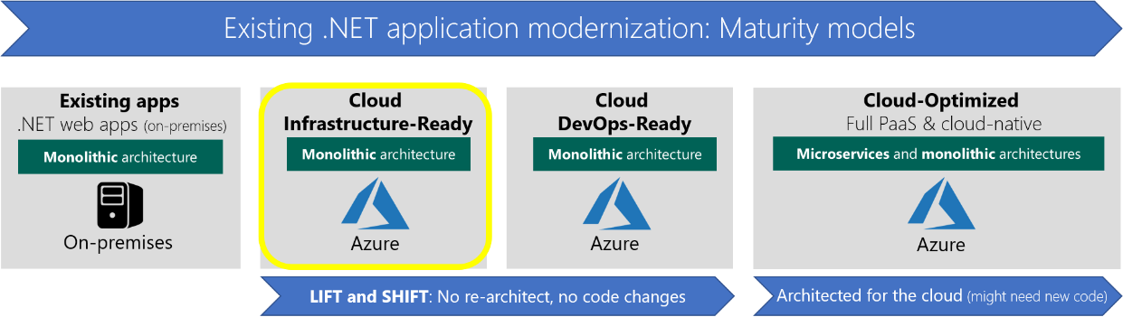
Positioning Cloud Infrastructure-Ready applications

Slide 28
Why ?
Why migrate existing .NET web applications to Azure IaaS?
Achieve cost reductions
lower its investment in
hardware maintenance
server or VM provisioning and deployment
infrastructure management
IaaS environment will be more familiar
lower learning curve

Slide 29
When?
When to migrate to IaaS instead of to PaaS
Most benefits from migrating to the cloud
Configuring, securing, and maintaining VMs requires much more time and IT expertise
Ongoing maintenance effort required to patch, update, and manage your VM environment

Slide 30
Azure Migrate
Azure Migrate is a new service that provides the guidance, insights, and mechanisms needed to assist you in migrating to Azure
Discovery and assessment for on-premises virtual machines
Inbuilt dependency mapping for high-confidence discovery of multi-tier applications
Intelligent rightsizing to Azure virtual machines
Compatibility reporting with guidelines for remediating potential issues
Integration with Azure Database Management Service for database discovery and migration

Slide 31
Azure Site Recovery
A tool that you can use to easily migrate your web apps to VMs in Azure
Can use to replicate on-premises VMs and physical servers to Azure, or to replicate them to a secondary on-premises location.
Can even replicate a workload that's running on a supported Azure VM, on an on-premises Hyper-V VM, on a VMware VM, or on a Windows or Linux physical server
Replication to Azure eliminates the cost and complexity of maintaining a secondary datacenter.

Slide 32
Implementing Azure Site Recovery

Slide 33
A common misconception is that IAAS VMs in Azure will always be available and no action is required
This is wrong
Services deployed to IAAS VMs must be consider availability in the architecture and planning

Slide 34
Disaster Recovery
Providing the processes and facilities to enable recovery in the event of a disruption to the primary services
Key Phases
What can go wrong
Types
RPO and RTO
Business Decisions

Slide 35
Other Services
Availability Sets
For regular IAAS VMs SLA of 99.95% at least two instances of a service must be deployed to VMs in an availability set or using VM Scale Sets
For single instance of VMs an SLA of 99.9% is available providing the VM uses premium storage
Azure Regions
Storage stamps are deployed to datacentres which live in an Azure region
Paired for geo-redundant storage replication
Load Balancers and Traffic Manager
Using a Load Balancer to front multiple instance of web services which provides resiliency and scalability for services within a region
Use a Traffic Manager to balance balance services across regions and even for instances on-premises

Slide 36
Azure Site Recovery
Azure Site Recovery is Microsoft’s Disaster Recovery as a Service Capability that protects server based workloads
Site Recovery helps ensure business continuity by keeping your apps running on VMs and physical servers available if a site goes down.
Site Recovery replicates workloads running on VMs and physical servers so that they remain available in a secondary location if the primary site isn't available. It recovers workloads to the primary site when it's up and running again.

Slide 37
Azure Site Recovery
Azure Site Recovery orchestrates and manages disaster recovery for workloads running on Hyper-V, VMware and even physical servers
Site Recovery can manage replication for:
Azure VMs replicating between Azure regions.
On-premises virtual machines and physical servers replicating to Azure, or to a secondary site.
Replication→ Failover →Failback

Slide 38
Common Use Cases
Planned Failover
You perform the failover ahead of the disaster striking ina controlled manner for testing or business needs which enables any outage to be at a time of your choosing and there should be no unexpected data loss
Unplanned Failover
Failover is forced causing an outage that you don’t choose the time of and there could be data loss
Testing and Staging
Mirror production deployment to azure USE DR copy as testing/staging environment
Migration
Replicate to azure, validate the deployment, application behaviours . Disconnect from op premises

Slide 39
Pre Requisites
Azure Subscription
Any licensing methods EA, CSP, Pay as you go
Azure Storage
Standard or premium
Premium support the Locally reductant)LRS)
Standard support Locally Redundant (LRS) or Geo redundant (GRS)
Azure Virtual Network
Failed over VM connect to this network
Must be on same regions as the vault
Recovery service vault
Management container or interface for the site recovery and backup

Slide 40
ASR Licensing
Recovery to customer owned data center
Free for first 31 days :$16/month per protected instance thereafter
Recovery to Azure
Free for first 31 days :$25/month per protected instance thereafter
Can also be licensed via Operational management suite via $35/node which includes all the features of OMS

Slide 41
Steps for Azure to Azure
Create a Recovery Services vault. The vault contains configuration settings and orchestrates replication.
Choose the Source Region, Deployment Model and Resource Group
Select VMs to protect
Customize the target resources and replication policy
Enable replication for the Azure VMs
Create a Recovery Plan
Run a test failover to make sure that everything's working as expected.
Clean the failover resources

Slide 42
Recovery Service Vaults
House backup and recovery services
Created in a specific region closest to your services
Data is sent to internet exposed ExpressRoute endpoint which can also be contacted via ExpressRoute where public peering is enabled

Slide 43
Recovery Plans
Enable workloads to be grouped and stated in order
Integration with Azure Automation and manual actions enables wide-range of scenarios to be covered
Cannot Mix Hyper V -V/ESXi protected VMs in single plan

Slide 44
Demo Azure Site Recovery

